Slide 1
Biased TextRank: Unsupervised Graph-Based Content Extraction
By: Arian Tashakkor

Slide 2
Presentation Structure
Introduction
TextRank
Random Walk with Restart
Biased TextRank
Methodology
Results
Experiments
Conclusion
References

Slide 3
Introduction

Slide 4
TextRank
The original premise of TextRank(Mihalcea et. al, 2004):
“A graph-based technique for key phrase extraction and text
summarization which implicitly implements a recommendation
system by using PageRank on a graph constructed from a text.”

Slide 5
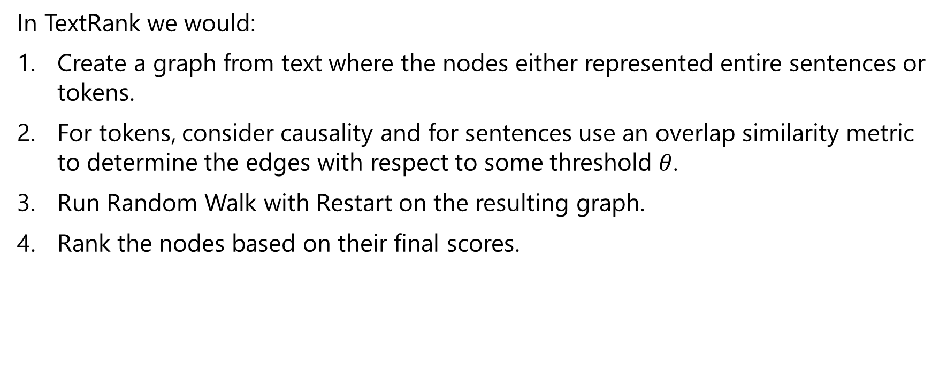
TextRank
In TextRank we would:
Create a graph from text where the nodes either represented entire sentences or tokens.
For tokens, consider causality and for sentences use an overlap similarity metric to determine the edges with respect to some threshold $θ$.
Run Random Walk with Restart on the resulting graph.
Rank the nodes based on their final scores.

Slide 6
Random Walk with Restart
Random Walk with Restart is an algorithm that aims to estimate the “closeness” between two nodes in a graph.
Random Walk:
Starting from some initial node, choose a neighbor node to go to at random.
The task is to estimate which nodes are you more likely to end up at after a finite number of steps.
Random Walk with Restart:
Same as Random Walk, except this time there are teleportation nodes that allow you to jump to a random node on the graph that isn’t necessarily a neighbor.

Slide 7
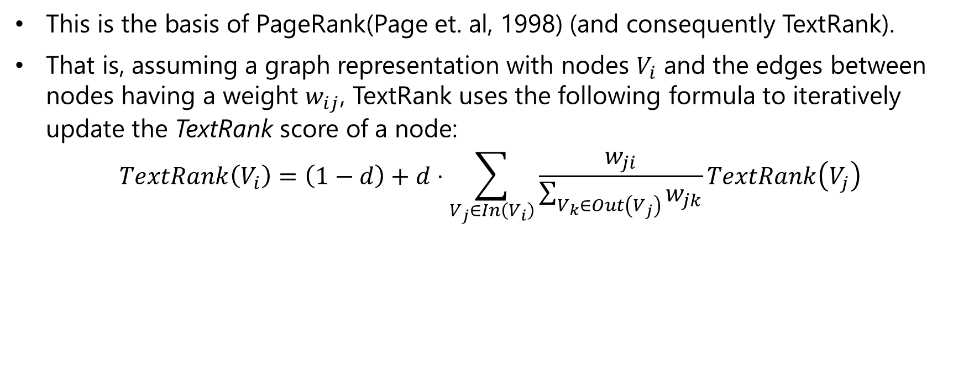
Random Walk with Restart
This is the basis of PageRank(Page et. al, 1998) (and consequently TextRank).
That is, assuming a graph representation with nodes $V_{i}$ and the edges between nodes having a weight $w_{ij}$, TextRank uses the following formula to iteratively update the TextRank score of a node:
$$TextRank\left(V_{i}\right)=\left(1−d\right)+d⋅\sum_{V_{j}∈In\left(V_{i}\right)}{\frac{w_{ji}}{\sum_{V_{k}∈Out\left(V_{j}\right)}{w_{jk}}}TextRank\left(V_{j}\right)}$$
Restart
Random Walk

Slide 8
Biased TextRank

Slide 9
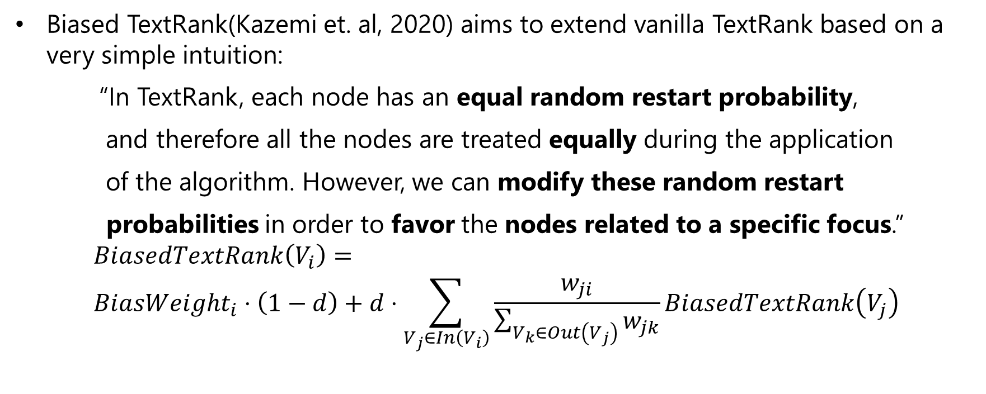
Methodology
Biased TextRank(Kazemi et. al, 2020) aims to extend vanilla TextRank based on a very simple intuition:
“In TextRank, each node has an equal random restart probability,
and therefore all the nodes are treated equally during the application
of the algorithm. However, we can modify these random restart
probabilities in order to favor the nodes related to a specific focus.”
$$BiasedTextRank\left(V_{i}\right)= \\ BiasWeight_{i}⋅\left(1−d\right)+d⋅\sum_{V_{j}∈In\left(V_{i}\right)}{\frac{w_{ji}}{\sum_{V_{k}∈Out\left(V_{j}\right)}{w_{jk}}}BiasedTextRank\left(V_{j}\right)}$$
Restart
Random Walk

Slide 10
Methodology
Biased TextRank starts with a document, and produces a ranking over text spans according to the biased TextRank formula shown earlier.
The algorithm consists of the following steps:
Parsing
Embedding
Graph Construction
Calculating Random Restart Probabilities
Executing RWR

Slide 11
Step 1: Parsing
Biased TextRank extracts relevant context from input documents by ranking document pieces. In order to do this, the documents are first parsed into those pieces.
Sentence-level tokenization for the task of sentence extraction
Word-level tokenization for the task of keyword extraction

Slide 12
Step 2: Embedding
In order to facilitate the computations, the document pieces are then transformed into mathematical representations which enables a similarity comparison between nodes.
Sentence-BERT (SBERT) is used for sentence-level tokens
Word embedding models like Word2Vec are used for word-level tokens.

Slide 13
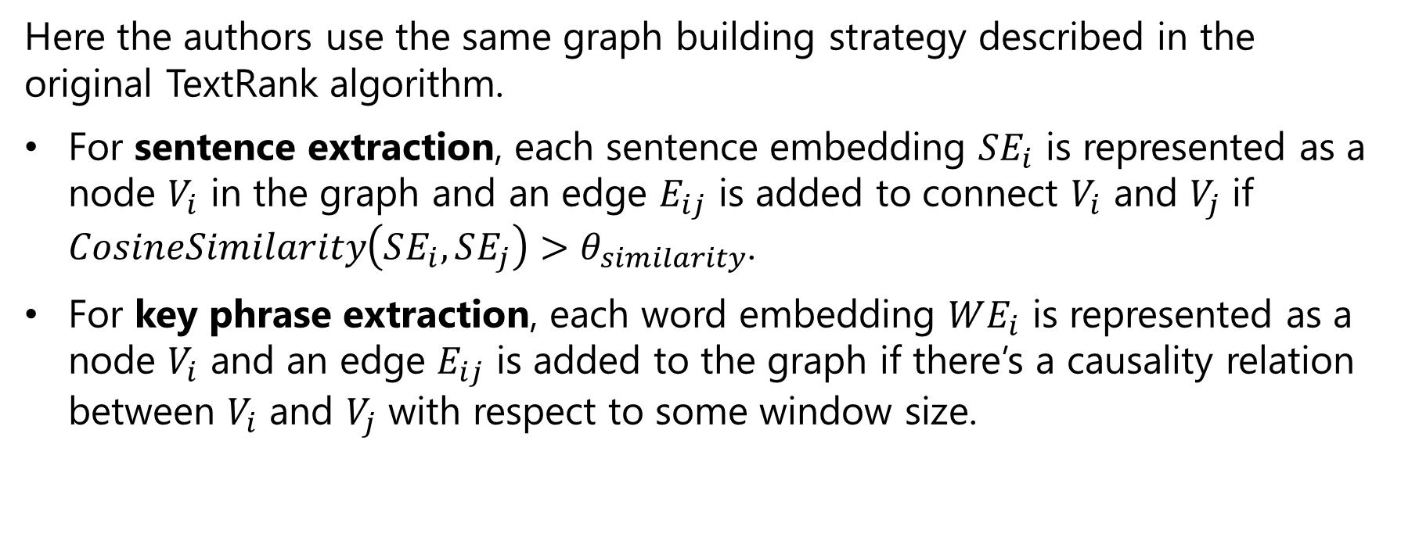
Step 3: Graph construction
Here the authors use the same graph building strategy described in the original TextRank algorithm.
For sentence extraction, each sentence embedding $SE_{i}$ is represented as a node $V_{i}$ in the graph and an edge $E_{ij}$ is added to connect $V_{i}$ and $V_{j}$ if $CosineSimilarity\left(SE_{i},SE_{j}\right)>θ_{similarity}$.
For key phrase extraction, each word embedding $WE_{i}$ is represented as a node $V_{i}$ and an edge $E_{ij}$ is added to the graph if there’s a causality relation between $V_{i}$ and $V_{j}$ with respect to some window size.

Slide 14
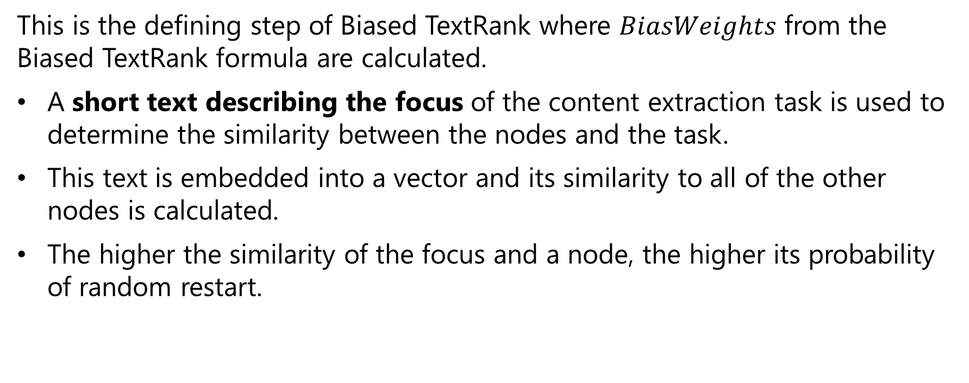
Step 4: Calculating Random Restart Probabilities
This is the defining step of Biased TextRank where $BiasWeights$ from the Biased TextRank formula are calculated.
A short text describing the focus of the content extraction task is used to determine the similarity between the nodes and the task.
This text is embedded into a vector and its similarity to all of the other nodes is calculated.
The higher the similarity of the focus and a node, the higher its probability of random restart.

Slide 15
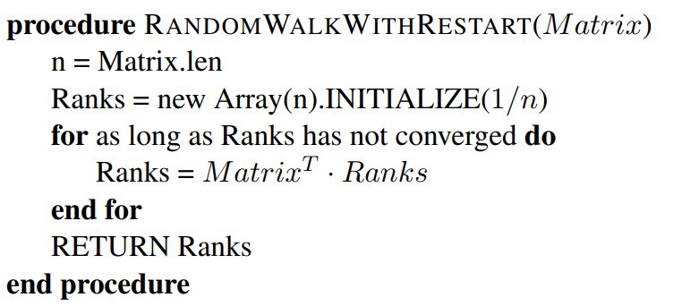
Step 5: Executing RWR
Finally, Random Walk with Restart using biased restart probabilities is executed until convergence using a similar procedure as described in PageRank:

Slide 16
Results
The authors show the results of Biased TextRank in comparison with similar techniques in two categories:
Focused Summarization: aims to generate summaries for an input text with a given focus.
Explanation Extraction: focuses on extracting explanations from articles elaborating on the veracity of a set of statements made about those articles.

Slide 17
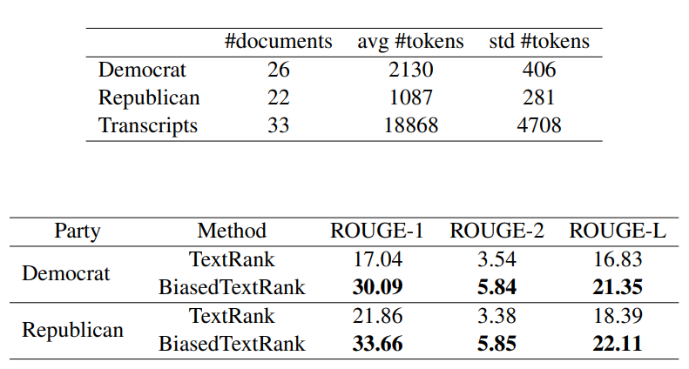
Results: Focused Summarization
Dataset: collection of news reportage from Democrat and Republican media’s interpretation of U.S. presidential debates from 1980 to 2016.
Task: reproduce the news reportage that summarized the events of the debates using Biased TextRank.
Top 20 ranked sentences
taken as focused summary.

Slide 18
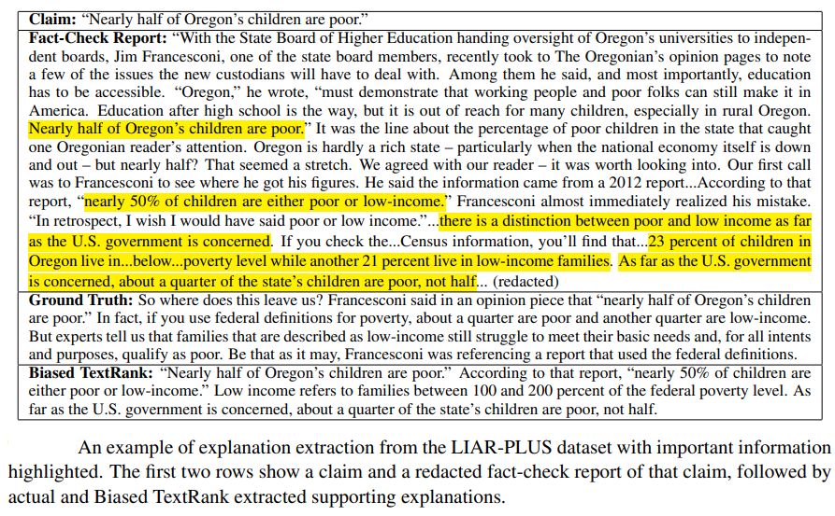
Results: Explanation Extraction
Dataset: Statements and articles from the LIAR-PLUS dataset.
Task: Extract the closing statement (explanation) from a lengthy justifying article.

Slide 19
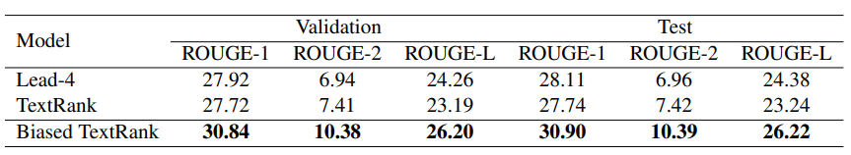
Results: Explanation Extraction
Dataset: Statements and articles from the LIAR-PLUS dataset.
Task: Extract the closing statement (explanation) from a lengthy justifying article.
Top 4 ranked sentences chosen as explanation.

Slide 20
Experiments

Slide 21
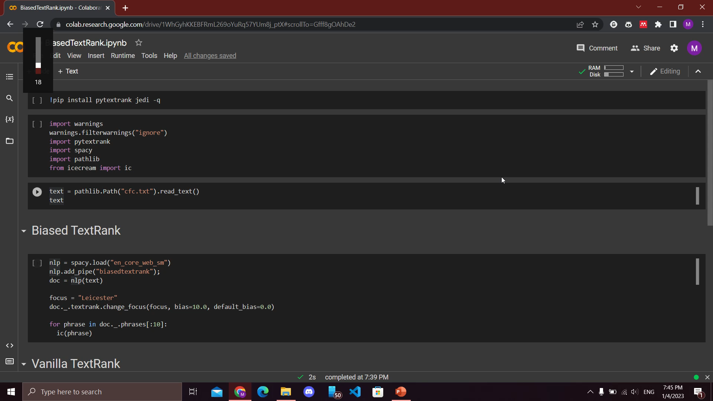
Experiments

Slide 22
Conclusion

Slide 23
Conclusion
In this presentation we introduced Biased TextRank, an unsupervised graph-based algorithm for directed extraction of content from text.
Biased TextRank is unsupervised and is demonstrated to be fast, resource-efficient, language-agnostic and easy to implement.
Effectiveness of Biased TextRank is shown on two tasks: focused summarization and explanation extraction. In both cases Biased TextRank outperforms similar previous works.

Slide 24
References
Mihalcea, R., & Tarau, P. (2004, July). TextRank: Bringing order into text. In Proceedings of the 2004 conference on empirical methods in natural language processing (pp. 404-411).
Brin, S., & Page, L. (1998). The anatomy of a large-scale hypertextual web search engine. Computer networks and ISDN systems, 30(1-7), 107-117.
Kazemi, A., Pérez-Rosas, V., & Mihalcea, R. (2020). Biased TextRank: unsupervised graph-based content extraction. arXiv preprint arXiv:2011.01026.
Bhatia, C. (2019, April 8). Random Walk with Restart and its applications. Medium. https://medium.com/@chaitanya_bhatia/random-walk-with-restart-and-its-applications-f53d7c98cb9
Vatsal. (2022, May 20). Random walks with restart explained. Medium. https://towardsdatascience.com/random-walks-with-restart-explained-77c3fe216bca

Slide 25
Thank you for your attention

